Slide 1
Blocked
Abraham George | Amirpouya Hemmasian | Charlotte Avra | Connor Geshan | Yayati Jadhav

Slide 2
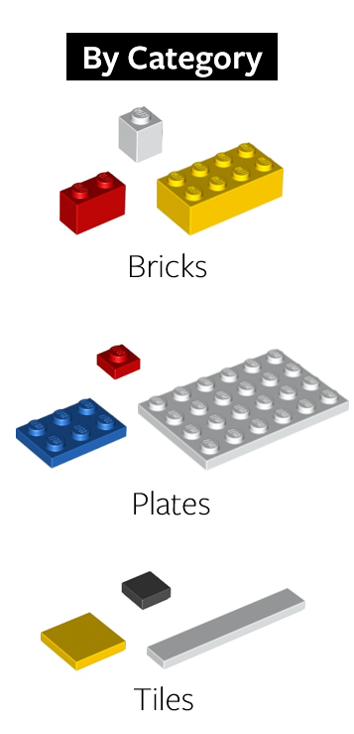
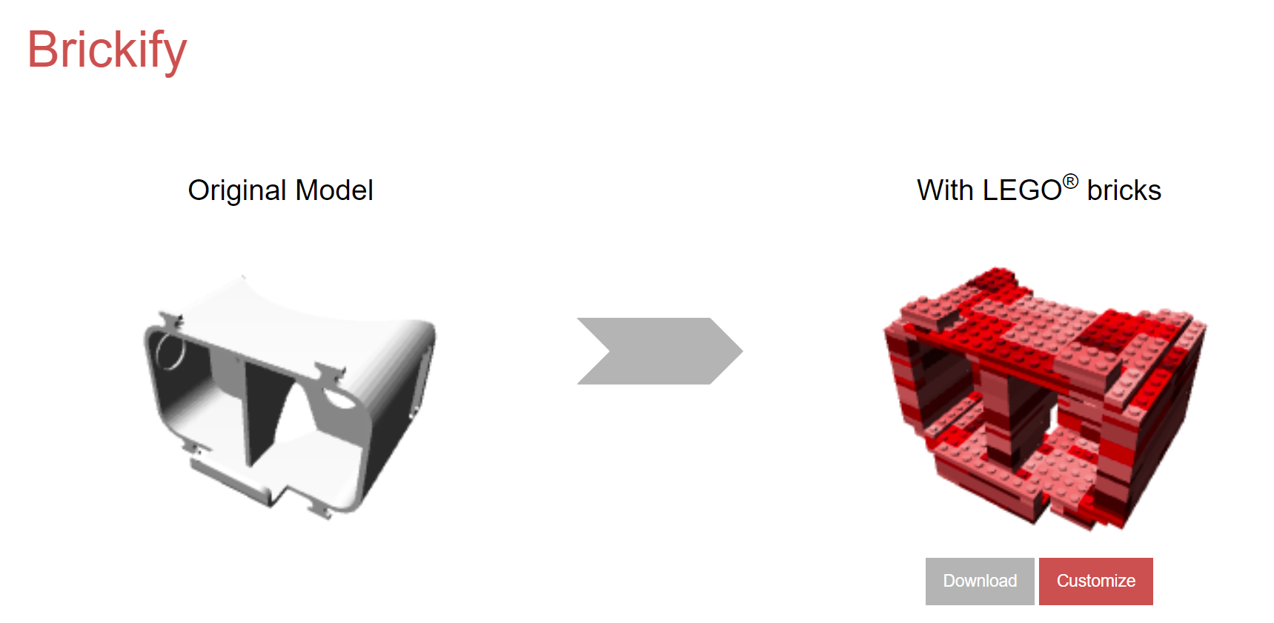
What the program will do:
Program inputs an STL file and simplifies it into smaller block units
Simplest = Use single block type
More complex = User can choose which types of blocks to use
Provides stability analysis of different possible assemblies
Outputs BOM with block type and quantity of each required
Shows layerwise steps for laying bricks (implement slider bar)
User interface
Source: brickify.it
Notes:
BOM : Bill of material

Slide 3

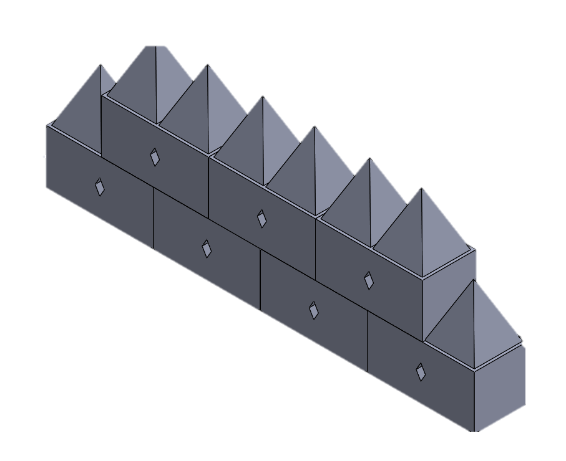
Why we chose this topic:
Engineering Motivation: Drone additive manufacturing
Inspired by a lab project where we are trying to use CrazyFlie drones to assemble structures
Use 3D printed blocks as building material.
To simply construction, speed up printing, and increase interchangeability, we only want to use a few block types but the number/shapes of these is flexible.
Requires us to convert an STL file into instructions for building it using blocks.
Similar role to a 3D printer’s slicer program.
Generally, this can be usefully for building any structure out of smaller units.
Lowering prototyping time.
3D printing takes too long to make a prototype
A software that can give block based plan would make initial prototyping significantly faster.

Slide 4
How are we going to do it…
Step 1: Handle STL file convert it to point clouds
Step 2: Voxelize the point cloud to smallest building block of 1x1.
Step 3: Layout based on Testuz et al.[1] algorithm for assembly with objective of maximizing stability.
Algorithm:
Initialize: Voxel, num_voxels, voxel_id_list
for 0 to num_voxels
Initialize: neighbour_list
Select random voxel_id from list
list(neighbour_list) <-- find legal set of neighbours
For neighbor in neighbour_list
Select neighbour with lowest cost value.
[1]Testuz, R.P., Schwartzburg, Y. and Pauly, M., 2013. Automatic generation of constructable brick sculptures (No. CONF, pp. 81-84).
Notes:
First we load in an stl mesh and sample point on the surface if the mesh
Then we voxelize the generated point clouds to the smalles block of 1x1 in
#2 Legofying: converting the 3D model into Legos
Figure 10 shows how faBrickator converts the 3D model into Lego‚Äôs smallest building blocks‚Äîthe 1x1 Lego plates. faBrickator first determines the bounding box of the model and extends it to the full multitude of a 1x1 Lego plate (8x8x3.2mm). Afterwards, faBrickator fills the bounding box with Lego plates in those positions that are either inside the model or share a portion of the volume with it. The remaining locations are left empty.

Slide 5
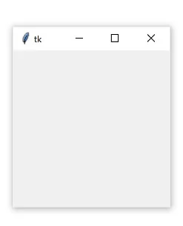
Why it is of reasonable difficulty for this project:
Combine FsSimpleWindow with a standard GUI Library
Render STL file
Generation of cost function to optimize block selection and assembly/stackability
Selection of block type to minimize overall fabrication cost
Recompilation of voxelized parts into a single structure
Stability analysis post voxelization

Slide 6
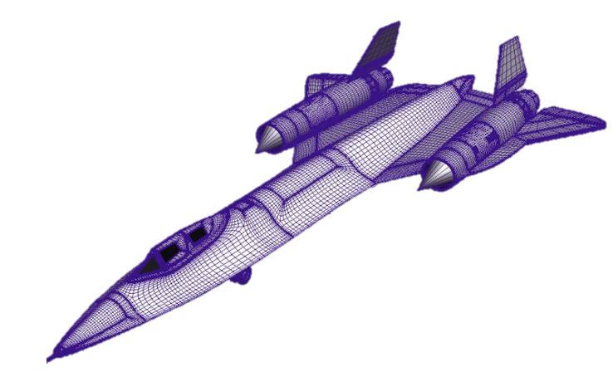

Why it is of reasonable difficulty for this project:
Combine FsSimpleWindow with a standard GUI Library
Render STL file
Generation of cost function to optimize block selection and assembly/stackability
Selection of block type to minimize overall fabrication cost
Recompilation of voxelized parts into a single structure
Stability analysis post voxelization

Slide 7
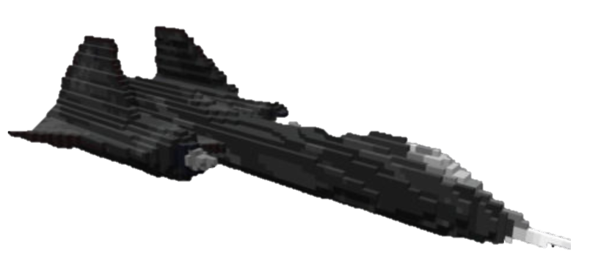
Why it is of reasonable difficulty for this project:
Combine FsSimpleWindow with a standard GUI Library
Render STL file
Generation of cost function to optimize block selection and assembly/stackability
Selection of block type to minimize overall fabrication cost
Recompilation of voxelized parts into a single structure
Stability analysis post voxelization

